Slide 1
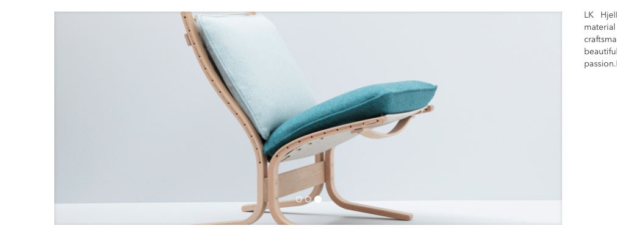
Siesta Trio
Byttes med dette bildet: https://www.dropbox.com/s/phdjy7vea9qih79/Hjelle_Siesta%20Trio%20%20new%202020.jpg?dl=0

Slide 2
Molto bytter navn til Molto Flex
Ny tekst på Molto Flex:
MOLTO Flex is a sofa system that offers many creative options and solutions. MOLTO Flex is adapted to smaller, intimate meeting situations. On the other hand, MOLTO Flex can easily fit into a private living room thanks to its simplicity and classic form. In the high version, MOLTO Flex is like a haven in noisy surroundings.
MOLTO Flex is a result of the cooperation between Norway Says and Hallgeir Homstvedt. They did a further development of our popular DUO sofa by bringing the language and function into a static format. Although the models individually are static, the MOLTO Flex system offers numerous opportunities and is highly adaptable to many situations. Due to the smart coupling fittings, the arm and back parts can be moved and the different modules can be switched. This provides a flexible sofa system that can vary high and low areas and easily be refurnished. 1, 2 and 3 seater with a high or low back are just the basic models. The modular system also allows you to build corner or open ended sofas.
Molto Flex has undergone a life cycle analysis in accordance with the EPD (Environmental Product Declaration)

Slide 3
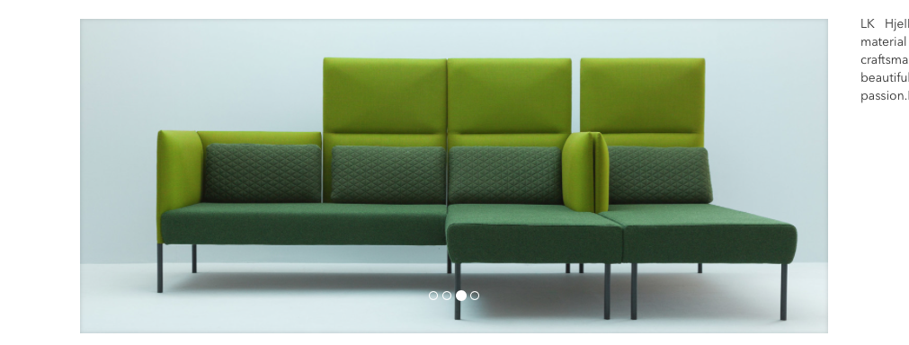
Nye bilder Molto Flex
Dette byttes med dette (både forsidebildet og inne på produktet ☺ ) https://www.dropbox.com/s/3izx0aafltqo90z/Hjelle_MoltoFlex-M20-11-0_M22-21-0_M20-22-2_Bardal750_Heidal760_Heddal710-2.jpg?dl=0

Slide 4
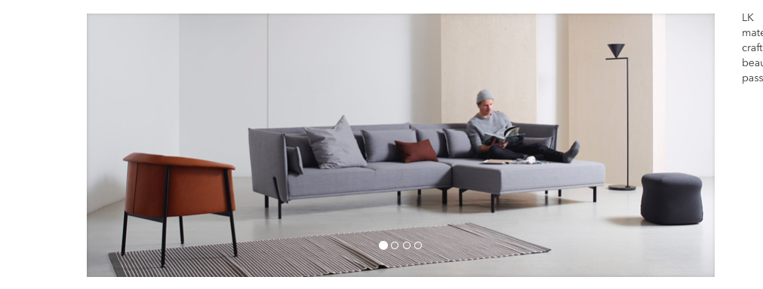
Nytt bilde Niu
Dette byttes med dette https://www.dropbox.com/s/f7otc59vwsu2ywi/Hjelle_Niu_combo%2017_%28108%2B202%29_Still%20481_3.jpg?dl=0

Slide 5
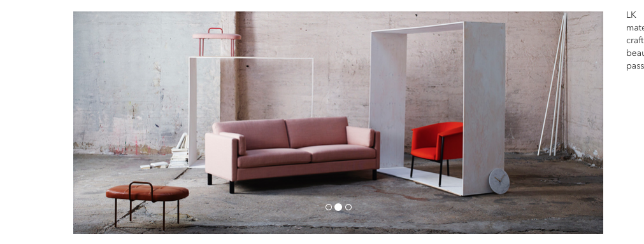
Nytt bilde Arena
Dette byttes med dette https://www.dropbox.com/s/4nnantrqe7qbt21/Hjelle_195A6082_Arena_Bardal_giraffben.jpg?dl=0

